Slide 1
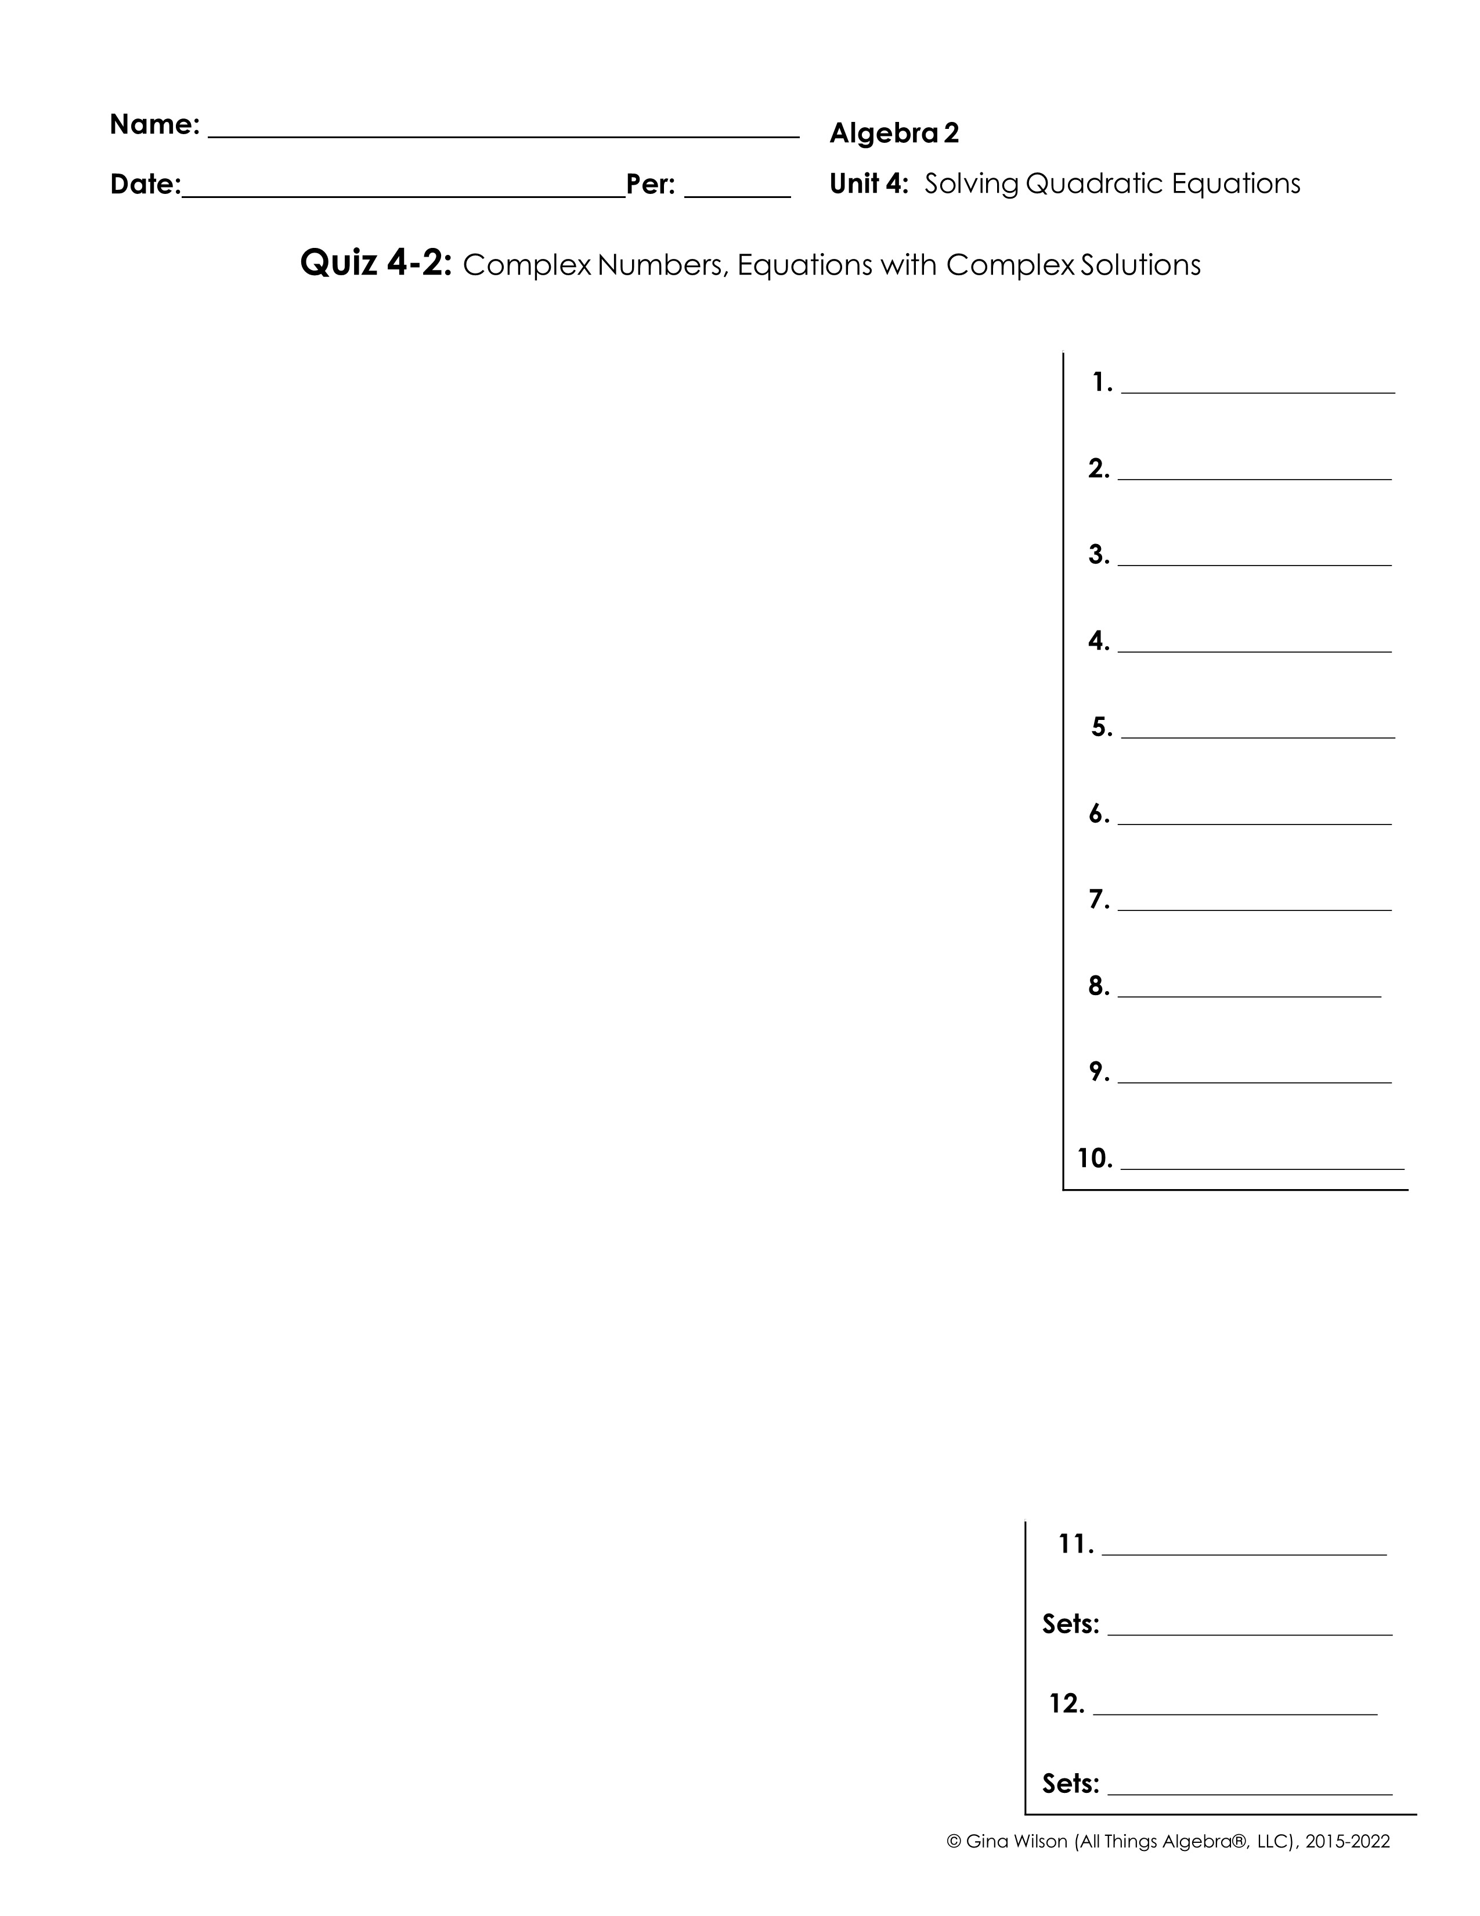
Simplify each expression.
1.
2.
3.
4.
5.
6.
7.
8.
9.
10.
Simplify, then name all sets to which each value belongs.
11.
12.

Slide 2
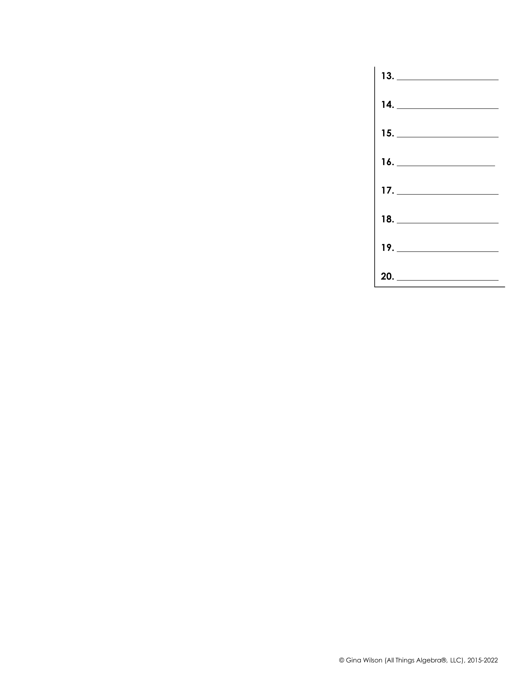
Solve using the square root property. Give all solutions in simplest form.
13.
14.
15.
16.
17.
18.
19.
20.

